Slide 1
DAX FUNCTION
BI Academy

Slide 2
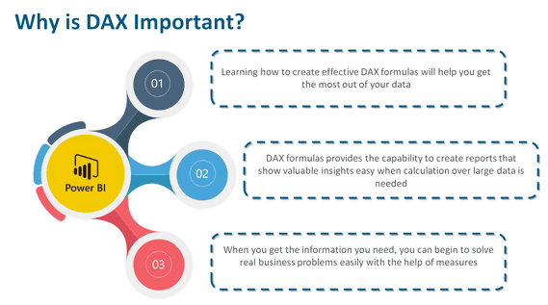

Slide 3
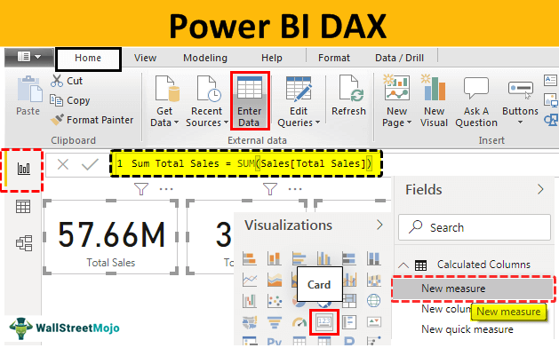

Slide 4
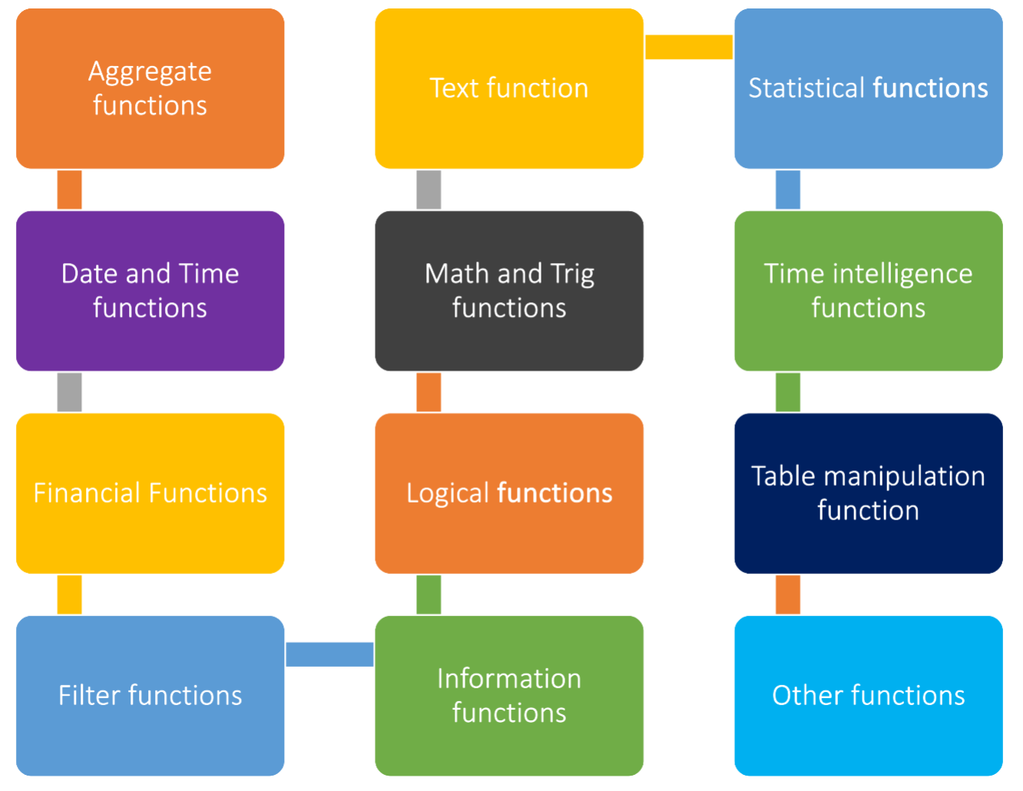
Types of dax functions

Slide 5
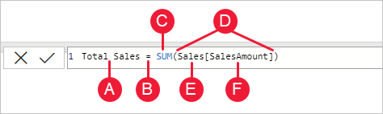
This formula includes the following syntax elements:
A. The measure name, Total Sales.
B. The equals sign operator (=), which indicates the beginning of the formula. When calculated, it will return a result.
C. The DAX function SUM, which adds up all of the numbers in the Sales[SalesAmount] column. You’ll learn more about functions later.
D. Parenthesis (), which surround an expression that contains one or more arguments. Most functions require at least one argument. An argument passes a value to a function.
E. The referenced table, Sales.
F. The referenced column, [SalesAmount], in the Sales table. With this argument, the SUM function knows on which column to aggregate a SUM.

Slide 6
SUM
Total Sales = SUM('master table'[Sales])
The DAX formula Total Sales = SUM('master table'[Sales]) calculates the sum of the 'Sales' column in the 'master table', giving you the total sales amount. You can use similar formulas to create other measures or calculated columns based on your specific analysis requirements.

Slide 7
SUMX
Total Sales per Customer = SUMX(VALUES('master table'[Customer ID]), CALCULATE(SUM('master table'[Sales])))
The SUMX function is used to sum the result of an expression evaluated for each row in a table.
Here's an example of how you might use SUMX:
Let's say you want to calculate the total sales for each customer by summing the 'Sales' column for each order they made.
In this example: VALUES('master table'[Customer ID]) provides a table of unique customer IDs. CALCULATE(SUM('master table'[Sales])) calculates the total sales for each customer using the context of the customer ID.
This measure, when placed in a visual or a table, will give you the total sales for each unique customer.

Slide 8
AVERAGE
Avg Sales per Order = AVERAGE('master table'[Sales])
is a measure that calculates the average sales amount per order in the 'master table’.
This is a straightforward calculation, and it should work as intended.
If you're encountering an error while creating a new table, it's important to understand the context in which you are trying to use this measure.
Measures are typically used in visualizations, cards, or tables to provide aggregated results. I
f you are trying to use this measure in a calculated column in a new table, it might not work as expected because measures are intended for use in the context of visualizations. Calculated columns in tables should typically use column-wise operations rather than aggregation functions like AVERAGE.

Slide 9
AVERAGEX
Average Sales and Profit per Order =
AVERAGEX(
'Master Table',
'Master Table'[Sales] + 'Master Table'[Profit]
)
This formula iterates over each row in the 'Master Table' and calculates the sum of 'Sales' and 'Profit' for each row.
Then, it calculates the average of these sums, giving you the average sales and profit per order.

Slide 10
COUNT and countrows
Count custID=
COUNT('Master Table'[Customer ID])
Num Orders = COUNTROWS('master table')
Count function Counts the number of rows in the specified column that contain non-blank values.
You can use the COUNT function to count column values, or you can use the COUNTROWS function to count table rows. Both functions will achieve the same result, providing that the counted column contains no BLANKs.

Slide 11
MAX
Max Sales = MAX('master table'[Sales])
This DAX formula calculates the maximum value from the 'Sales' column in the 'master table'. You can use a similar approach to create measures or calculated columns for other maximum-related analyses.

Slide 12
CALCULATE
Central Region Orders = CALCULATE(COUNTROWS('Location Table'), 'Location Table'[Region] = "Central")
COUNTROWS('master table'): This part of the formula counts the number of rows in the ‘location table' without any filters. CALCULATE(..., 'master table'[Region] = "Central"): This part of the formula modifies the filter context for the 'master table' by specifying that it should only consider rows where the 'Region' column is equal to "Central".

Slide 13
TOPN
Top 5 Products Sales =
CALCULATE(
SUM('master table'[Sales]),
TOPN(5, ALL('master table'), 'master table'[Sales], DESC))
It calculates the sum of 'Sales' for the top 5 products based on their sales amounts in descending order across the entire 'master table'. Here's a brief breakdown:
CALCULATE(SUM('master table'[Sales]), ...): This part of the formula calculates the sum of 'Sales' within the specified context.
TOPN(5, ALL('master table'), 'master table'[Sales], DESC): This part determines the top 5 rows from the 'master table' based on the 'Sales' column in descending order.
The ALL('master table') ensures that the calculation considers the entire table without any filters.

Slide 14
DISTINCT
count_distinct_rows = COUNTROWS(DISTINCT('Master Table'[Customer ID]))
It uses the COUNTROWS function in combination with DISTINCT to count the number of distinct values in the 'Customer ID' column from the 'Master Table'. This will give you the count of unique customer IDs in your dataset.
This measure will return the total number of unique customer IDs in the 'Master Table'. If you want to count distinct rows based on multiple columns, you can modify the formula accordingly.

Slide 15
FILTER
B2B MARKET SCENARIOS
CLOUD-BASED OPPORTUNITIES
Develop winning strategies to keep ahead of the competition
Capitalize on low-hanging fruit to identify a ballpark value
Visualize customer directed convergence
Iterative approaches to corporate strategy
Establish a management framework from the inside

Slide 16
CONTAINS
At Contoso, we believe in giving 110%. By using our next-generation data architecture, we help organizations virtually manage agile workflows. We thrive because of our market knowledge and great team behind our product. As our CEO says, "Efficiencies will come from proactively transforming how we do business."

Slide 17
IF
At Contoso, we empower organizations to foster collaborative thinking to further drive workplace innovation. By closing the loop and leveraging agile frameworks, we help business grow organically and foster a consumer-first mindset.

Slide 18
SWITCH
Annual revenue growth

Slide 19
DIVIDE
Profit Margin = DIVIDE(SUM('master table'[Profit]), SUM('master table'[Sales]))

Slide 20
EXCEPT
B2B MARKET SCENARIOS
CLOUD-BASED OPPORTUNITIES
Develop winning strategies to keep ahead of the competition
Capitalize on low-hanging fruit to identify a ballpark value
Visualize customer directed convergence
Iterative approaches to corporate strategy
Establish a management framework from the inside

Slide 21
GROUPBY
At Contoso, we empower organizations to foster collaborative thinking to further drive workplace innovation. By closing the loop and leveraging agile frameworks, we help business grow organically and foster a consumer-first mindset.

Slide 22
THANK YOU
Mirjam Nilsson​
mirjam@contoso.com
www.contoso.com

